Slide 1

Machine learning project
Topic:- Natural gas price prediction
Project Supervisor :-Ms.E.Srividhya. M.E., Ph.D.,
Name of the Student :- Mr.Jaffar Siddiq Syed.
Register Number :- 39111007.

Slide 2
Presentation Outline
Course Certificate
Introduction
Objectives and scope
System Architecture / Ideation Map
Methodology
Data visualization
Results and Discussions
Conclusion & Future work
References

Slide 3
Course Certificate
Acknowledgement :
Board of management of sathyabama
Hod of CSE department,
Dr.L.Lakshmanan, M.E.,Ph.D.,
Dr. T. Sasikala M.E., Ph.D
Dean
Dr. A. JESUDOSS, M.E., Ph.D.,

Slide 4
Introduction:-
This machine learning model helps us to predict the price of the gas in a given area.
Machine learning helps people to do more work as they learn to work like a human.
Machine learning is widely used in AI which is a dominant force in development.
This project uses machine learning algorithm for predicting the price of natural gas.
Forecasting natural gas prices is a powerful and essential tool which has become more important for different stakeholders in the natural gas market, allowing them to make better decisions for managing the potential risk, reducing the gap between the demand and supply, and optimizing the usage of resources based on accurate predictions.

Slide 5
Objectives:-
To predict Natural gas price using machine learning.
To understand decision tree regression algorithm.
To execute python code to predict.
To use python packages to plot and predict price changes.

Slide 6
Ideation Map
Collecting the data.
Analyzing the data and removing the null values.
Visualizing the analyzed data
Training the machine using train-split algorithm.
Predicting the value using natural gas price prediction.

Slide 7
Software Requirements
Software Requirements
• Operating System - Windows OS
• Coding Language - Python
• Tool - Jupyter Notebook
• Libraries - pandas, matplotlib

Slide 8
Methodology
Steps involved in this project :
Collection of data and analysing the data.
Accuracy of the model is important so removing of the null values is important, thus analyzing is important.
The analysed data is then used to train our model.
Using the train – test split algorithm to train our algorithm.
Using the trained model to predict the price of the gas.
Using the algorithm to predict the rate of natural gas the result.
Calculation of the accuracy value, which if higher than 90% tells us that our model work great.

Slide 9
This project uses,
Data sheet from the cognibot.
Inbuilt libraries in python like
Numpy
Matplotlib
Pandas
Inbuilt fuctions like
Seaborn
Random classifier
Train-test split
Classification report
Confusion
The inbuilt libraries are used to analyse the data i.e.
Numpy is used to work with arrays
Matplotlib is used to visualize the analysed data
Pandas helps us to retrieve data from data sheet into the mark-up

Slide 10
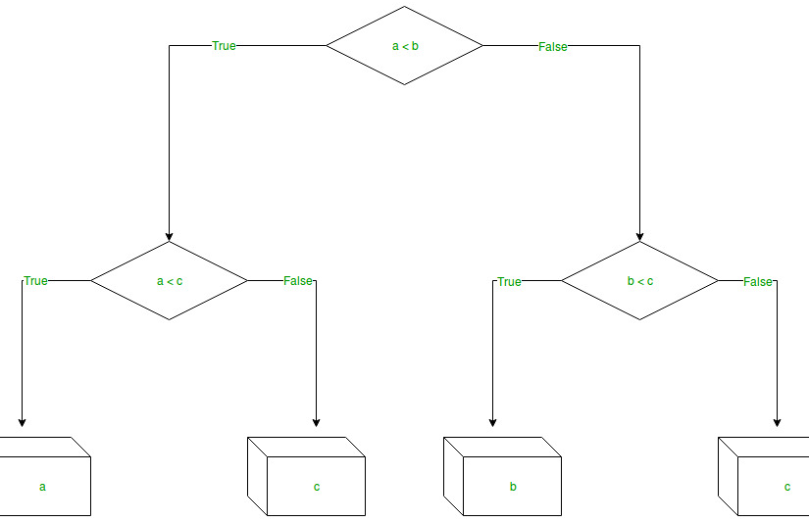

Slide 11
Implementation:-
Step 1: Import the required libraries.
Step 2: Initialise and print the Dataset.
Step 3: Select all the rows and column from the dataset to “X”.
Step 4: Select all of the rows and column from the dataset to “y”.
Step 5: Fit decision tree regressor to the dataset.
Step 6: Predicting a new value.
Step 7: Visualising the result.

Slide 12
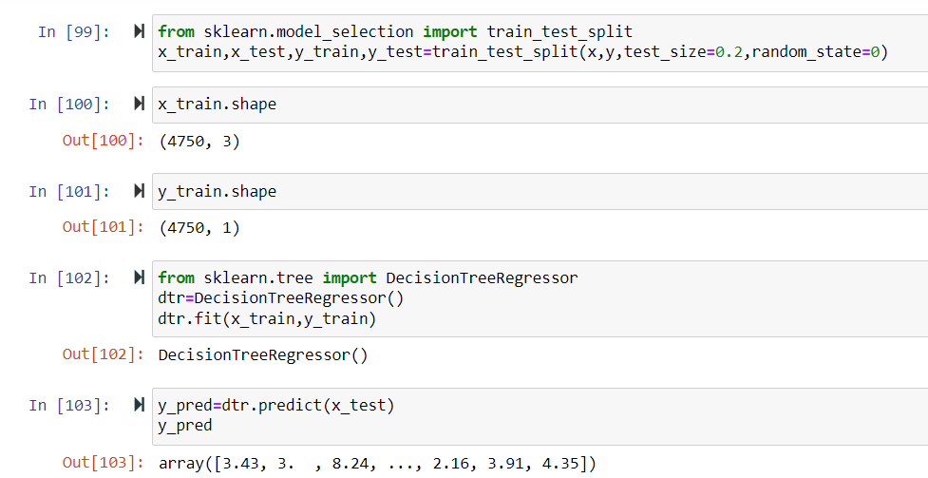
Training the machine :
We use the train test split algorithm to train the model with data.
This algorithm divides the data into 2 uneven parts.
The model is trained with the larger part of then it tries to predict the result using the remaining part of the data.
The model then trains itself from the second part of the data sheet reducing the work load on us.

Slide 13
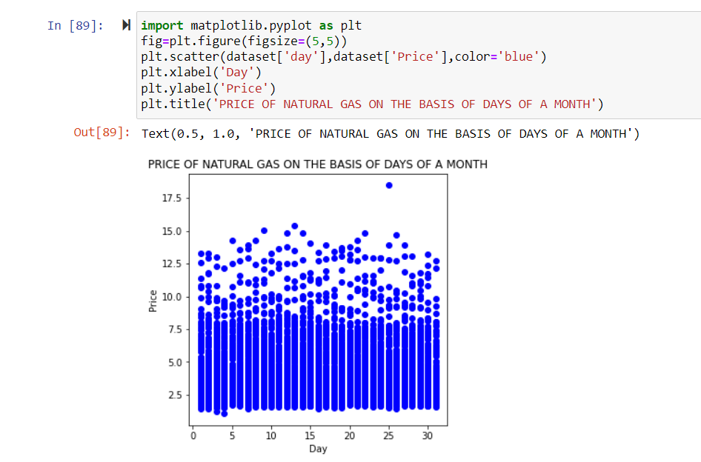
Data visualization:-

Slide 14
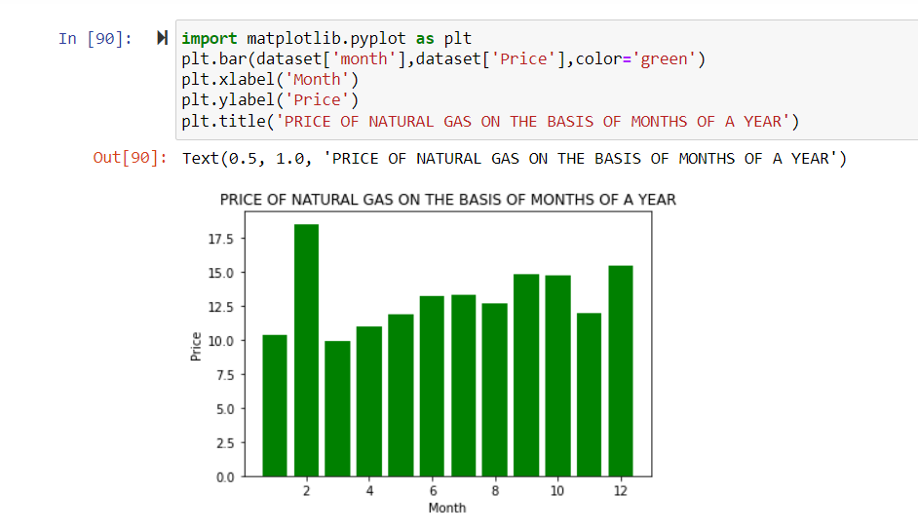

Slide 15
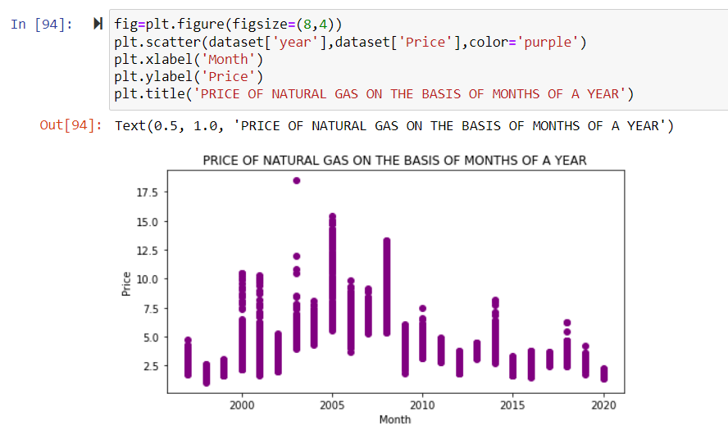
Hea

Slide 16
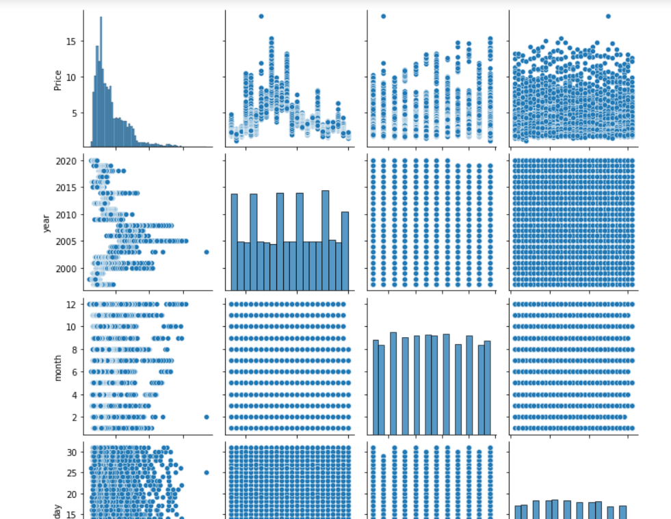
Box plot and bar plot

Slide 17
Results and Discussion
The program to predict the price of Natural Gas is executed using Python.
The year, month and date is taken as a input from the user.
Analysing the date, the price of the natural gas is predicted by implementing Decision tree regression.
Finally we can say that we have achieved 97% of accuracy.

Slide 18
Conclusion
Our model was able to use the data properly and achieve a respectable result
As the accuracy score of the prediction is 97% we can say that the model works good and has achieved the goal we visualized
The accuracy of the model can be still improved if the data is more analysed which is out the scope as it requires much precision in collection of the data
The random classifier has an attribute named n-estimators which increases the accuracy when increased, but its tough to use as the model takes more time than usual

Slide 19
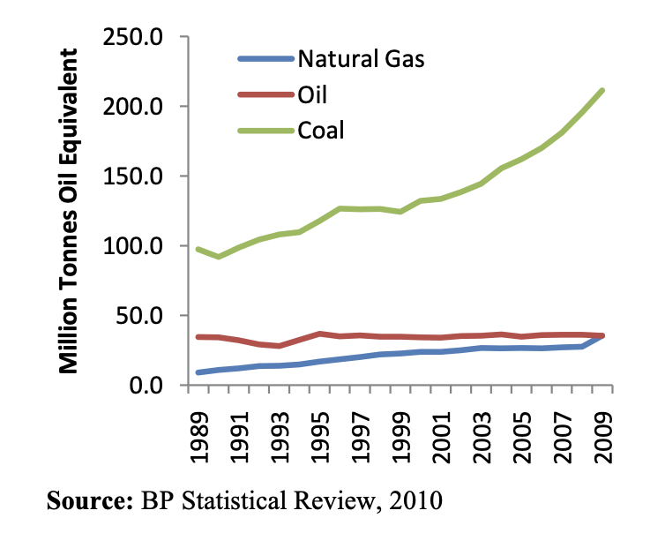
References:-
Indian GDP growth dropped to 5.7% in 2009, well below the previous years’ levels according to the IMF’s World Economic Outlook from July 2010.²⁰ The IMF expects Indian GDP to grow back to 9.4% and 8.4% in 2010 and 2011 respectively
working paper is based on some of the material in, Anil Jain, Natural Gas in India: Liberalisation and Policy, forthcoming, Oxford University Press, 2011.

